Slide 1
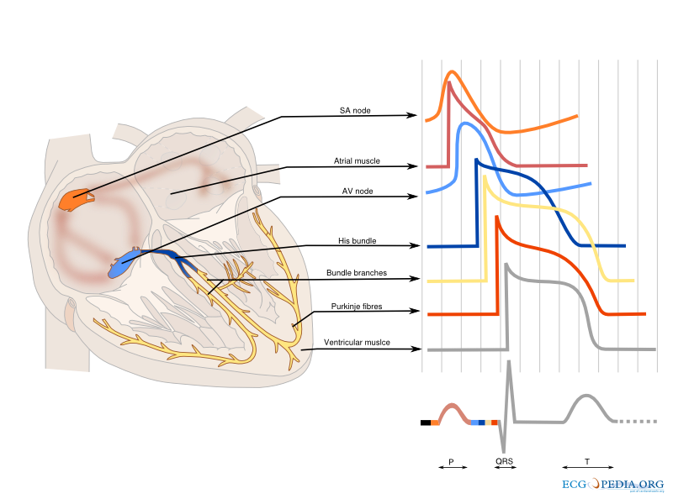
Arrhythmias
Brian Locke, MD
PGY2 Internal Medicine
University of Utah
Updated Apr 19, 2018

Slide 2
Objectives
Classify arrhythmias by speed, regularity, QRS width to establish a differential diagnosis
Determine if an AV block needs admission/referral for pacemaker placement?
What will occur if adenosine is given to a each narrow complex tachycardia?
Does this wide complex tachycardia require cardioversion, defibrillation, or neither?

Slide 3
Sources
Images from:
ecg.utah.edu
En.ecgpedia.org
https://lifeinthefastlane.com/ecg-library/basics/
BMJ ABC of EKG series
https://www.bmj.com/content/324/7334/415

Slide 4
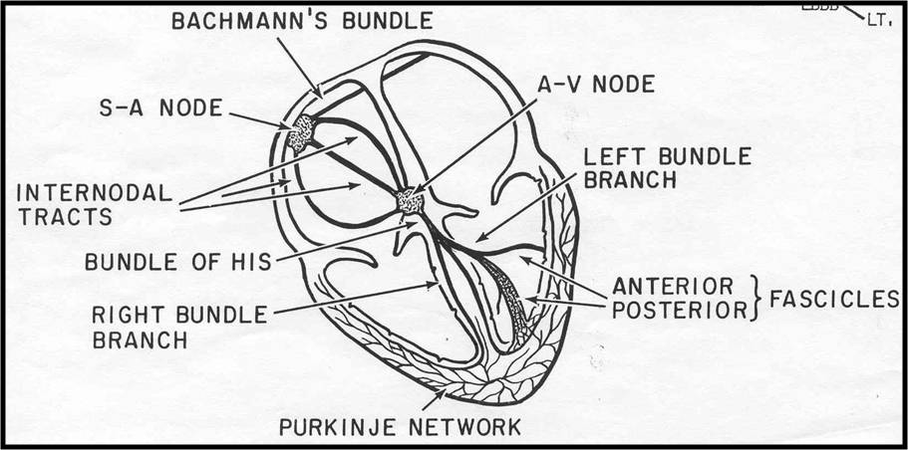
Review:
Normal Cardiac conduction

Slide 5
Approach to arrhythmias
Step 1:

Slide 6
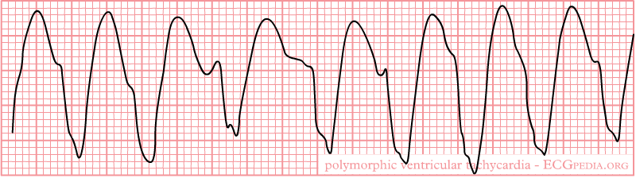
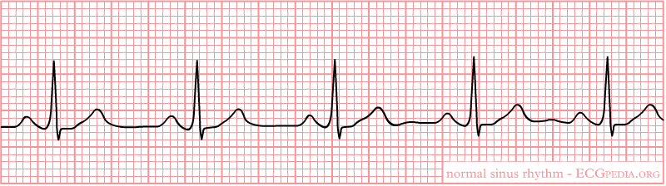
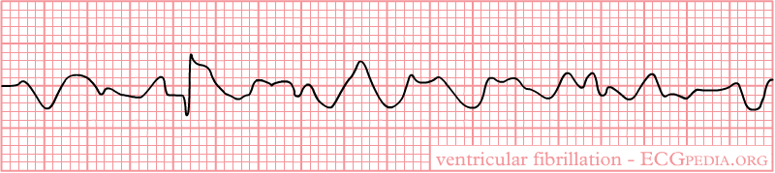
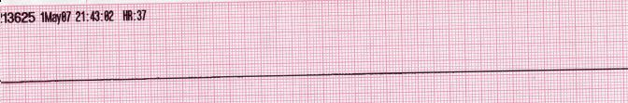
Approach to arrhythmias
Step 1: Do they have a pulse? If no, ACLS
CPR, AED/Monitor: are they in VT/VF or Asystole/PEA?
If tele strip is available, check the rhythm at the start
VT (Cardiac cause) | PEA (Hs and Ts.)
VF (Cardiac cause) | Asystole

Slide 7
Approach to arrhythmias
What is PEA?
Spectrum from severe shock (‘pseudo-PEA’) to complete electromechanical dissociation (‘EMD’)
Can differentiate with: High EtCO2, A-line, Bedside US
PEA Causes: Standard method – 4Hs and 4Ts.
Alternative = Littman Method:
QRS wide (0.12s or more) or narrow (less than 0.12s)
Narrow: Most commonly mechanical / RV / Obstruction
Wide: Most commonly metabolic, ischemic, or LV failure

Slide 8
Approach to arrhythmias
Step 1: Do they have a pulse? If yes, get vitals, an EKG +/- hook them up to monitor/defibrillator (e.g. HR < 40, SBP < 90)

Slide 9
Approach to interpretation of EKGS
Methodological approach, every time
Numerous variations
1. Rate 2. Rhythm 3. Axis 4. Conduction 5. Morphology

Slide 10
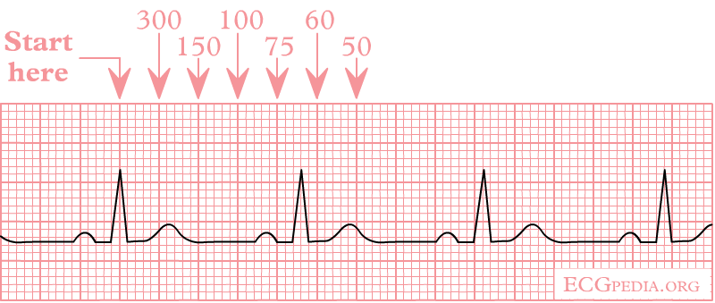
Ventricular Rate
300 / # small boxes
If Irregular: #QRS in 10 seconds (=the strip) * 6
Closer than 3 boxes = tachycardia.
Spaced more than 5 boxes = bradycardia
1. Rate 2. Rhythm 3. Axis 4. Conduction 5. Morphology
Notes:
Notice the difference from EKG basics – look at the VENTRICULAR rate

Slide 11
Rhythm
P-waves?
Regular?
P → QRS?
Every QRS preceded by P?
*P wave upright in II
Eg 1
1. Rate 2. Rhythm 3. Axis 4. Conduction 5. Morphology

Slide 12
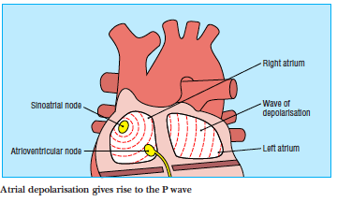
Rhythm
Is it sinus?
P-waves?
Regular?
P → QRS?
Every QRS preceded by P?
P wave upright in II
Eg 1
1. Rate 2. Rhythm 3. Axis 4. Conduction 5. Morphology

Slide 13
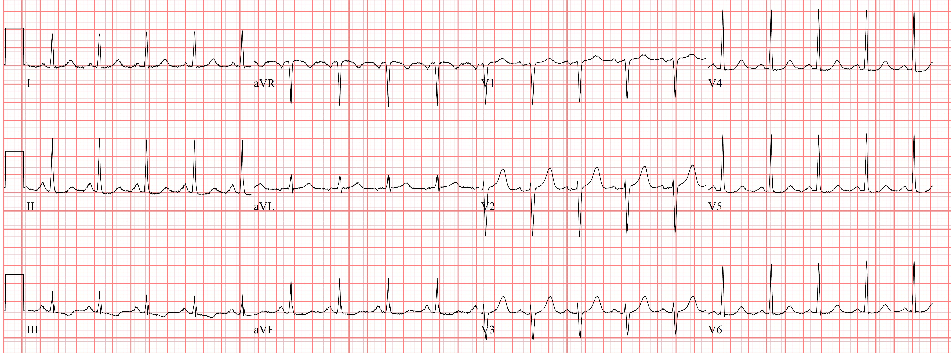
Rhythm
P-waves?
Regular?
P → QRS?
Every QRS preceded by P?
*P wave upright in II
Eg 1
1. Rate 2. Rhythm 3. Axis 4. Conduction 5. Morphology
Notes:
HR 120, sinus, normal axis, normal conduction, no signs of ischemia

Slide 14
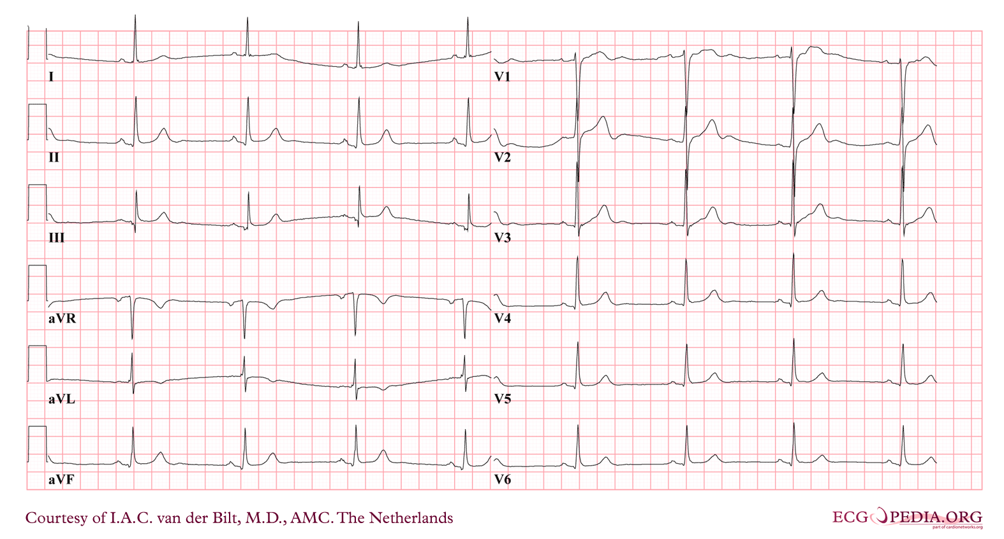
Rhythm
Sinus Brady
1. Rate 2. Rhythm 3. Axis 4. Conduction 5. Morphology
Notes:
DDx:
AMI
Drugs
Hypothyroidism
Obstructive Jaundice
Increased intracranial pressure
Hypothermia
Sinus node dysfunction / SSS

Slide 15
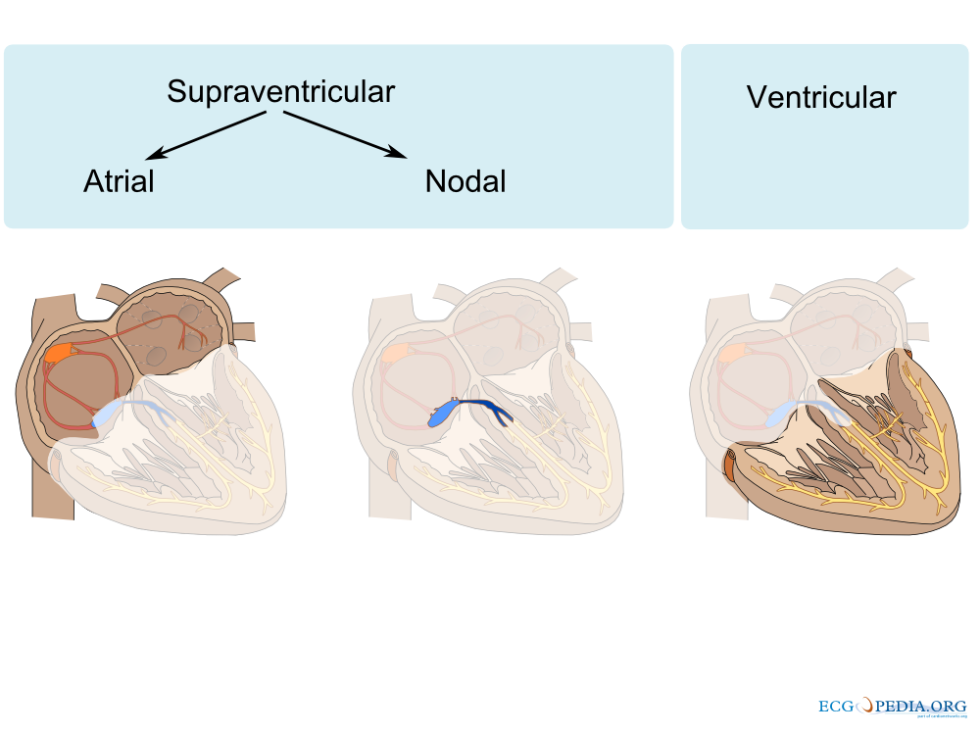
Classification

Slide 16
arRhythmias
Not Sinus?
Classify based on:
Speed, regularity, and QRS width
Information gathering:
*We already know speed: Fast or slow? Regular?
What is the QRS width?
Look for P-waves
Is there a relationship between p-waves and QRS complexes?
1. Rate 2. Rhythm 3. Axis 4. Conduction 5. Morphology

Slide 17
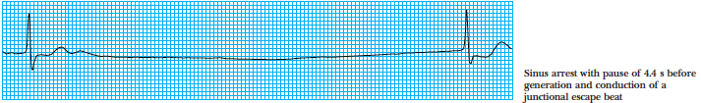
Bradycardia
Differential
Sinus: (see previous slides)
Variations: Tachy-Brady, Sinus arrest w/ escape
AV block
Notes:
Generally tolerated at rest until HR < 40

Slide 18
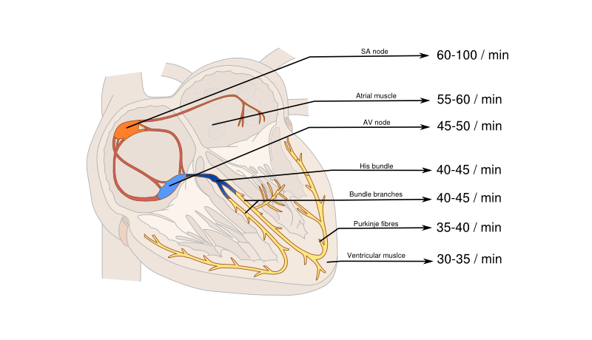
Ectopic Pacemakers

Slide 19
Conduction
AV Block
1st Degree | Prolonged PR (0.2 ms+)
2nd Degree Type 1 (Wenkebock) | PR lengthens, until a QRS is not conducted
2nd Degree Type 2 | No PR lengthening prior to non conducted QRS
High Degree | So many non-conducted QRS that you can’t tell (<2:1)
3rd Degree | No conducted QRS complexes (both P-P and QRS-QRS are regular and different)
1. Rate 2. Rhythm 3. Axis 4. Conduction 5. Morphology

Slide 20
Conduction
AV Block: At or below the level of the AV-node = risk of becoming complete heart block
1st Degree | Prolonged PR (0.2 ms+)
2nd Degree Type 1 (Wenkebock) | PR lengthens, until a QRS is not conducted
2nd Degree Type 2 | No PR lengthening prior to non conducted QRS
High Degree | So many non-conducted QRS that you can’t tell (<2:1)
3rd Degree | No conducted QRS complexes (both P-P and QRS-QRS are regular and different)
1. Rate 2. Rhythm 3. Axis 4. Conduction 5. Morphology
Notes:
His-perkinje or below = prone to becoming a complete block => 35% yearly risk of asystole

Slide 21
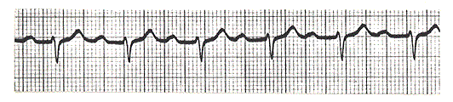
AV Block
Notes:
Type 1

Slide 22
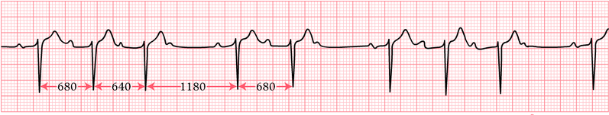
AV Block

Slide 23
AV Block

Slide 24
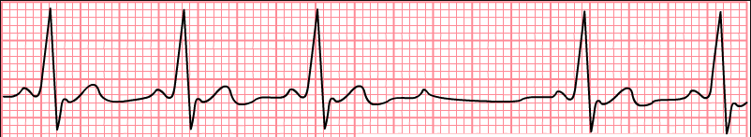
AV Block

Slide 25
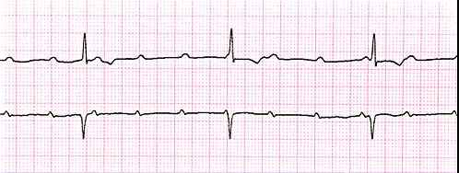
AV Block
Notes:
3rd degree

Slide 26
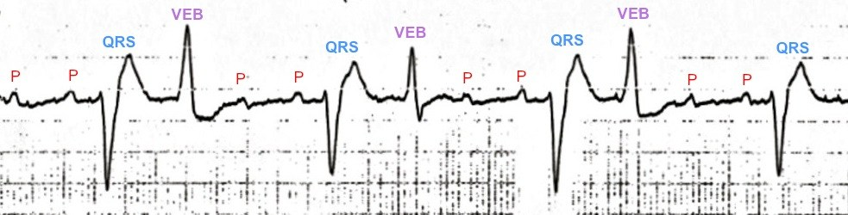
AV Block
Notes:
Atrial tachycardia + High grade AV block
4;1 (hidden in ventricular ectopic beat) = consistent PR = not completedly dissociated
Seen w/ digoxin

Slide 27
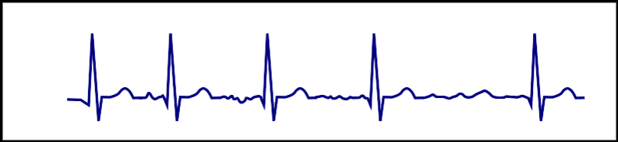
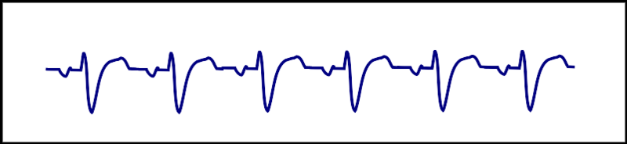
Tachycardia
Narrow or Wide?

Slide 28
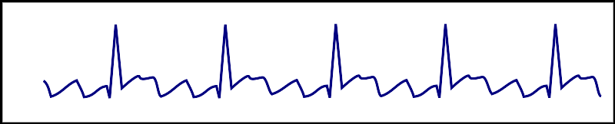
Narrow qrs Tachycardia
Origin = AV Junction or Higher
Regular or Irregular QRS rate?

Slide 29
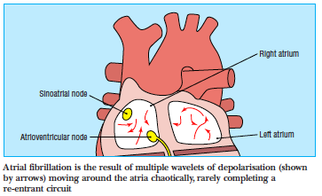
Irregular Narrow qrs Tachycardia
Atrial Fibrillation <-----→ Multifocal Atrial Tachycardia
Afib: Underlying atrial rhythm 400-600 bpm -> AV node only lets 75-170 beats through
Slow the AV node w/ BB/CCB -> rate control
Also consider Aflutter with variable block
Notes:
Atrial fibrillation can be catechorized as follows:
First documented episode
Recurrent atrial fibrillation: after two or more episodes.
Paroxysmal atrial fibrillation: if recurrent atrial fibrillation spontaneously converts to sinus rhythm.
Persisting atrial fibrillation: if an episode of atrial fibrillation persists more than 7 days.
Permanent atrial fibrillation: if atrial fibrillation persists after an effort of electrical or chemical cardioversion

Slide 30
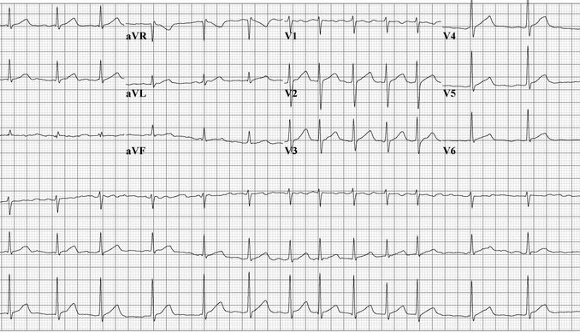
Irregular Narrow qrs Tachycardia

Slide 31
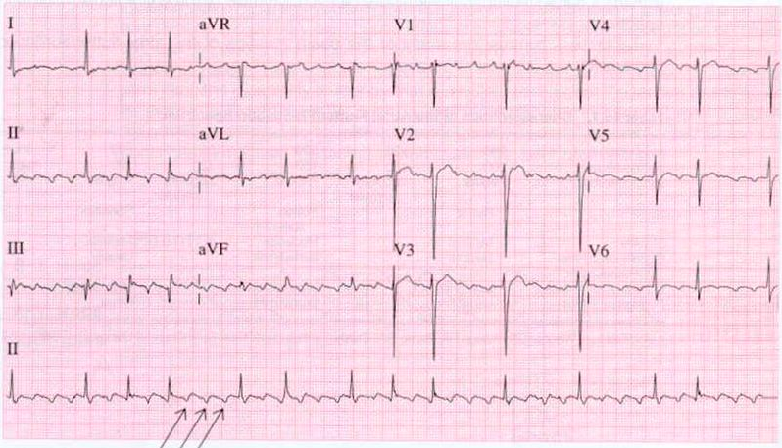
Irregular Narrow qrs Tachycardia

Slide 32
regular Narrow qrs Tachycardia
DDx:
Atrial tachycardia:
Atrial flutter
AVNRT
*AVRT
*Juncitonal tachycardia
Adenosine: AV nodal blocking agent -> drastically slows conduction through the AV node temporarily

Slide 33
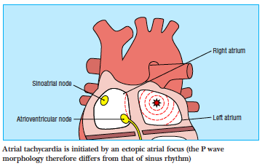
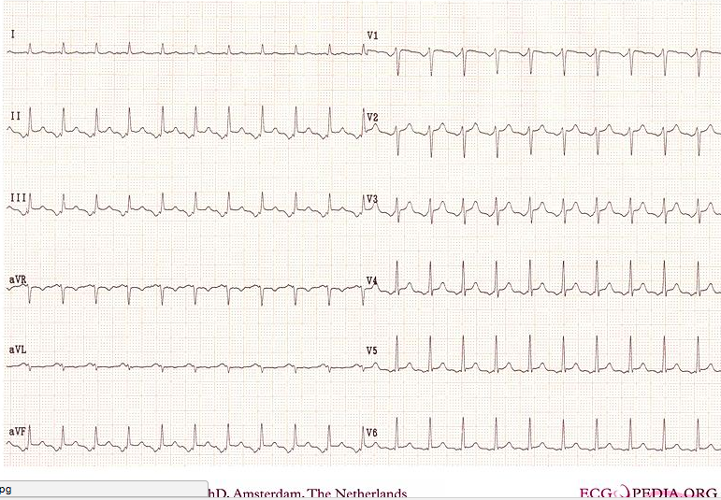
Atrial Tachycardia
Like sinus, except pacemaker is not in the SA node.

Slide 34
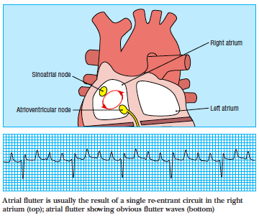
Atrial Flutter
Underlying rate: 300
Ventricular rate ~150 (2:1 block), ~100 (3:1 block), ~75 (4:1 block) depending how fast AV node resets

Slide 35
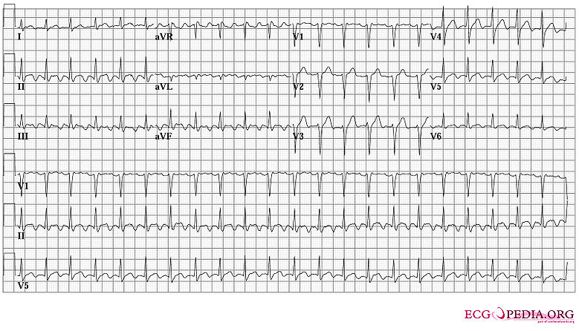
Atrial Flutter

Slide 36
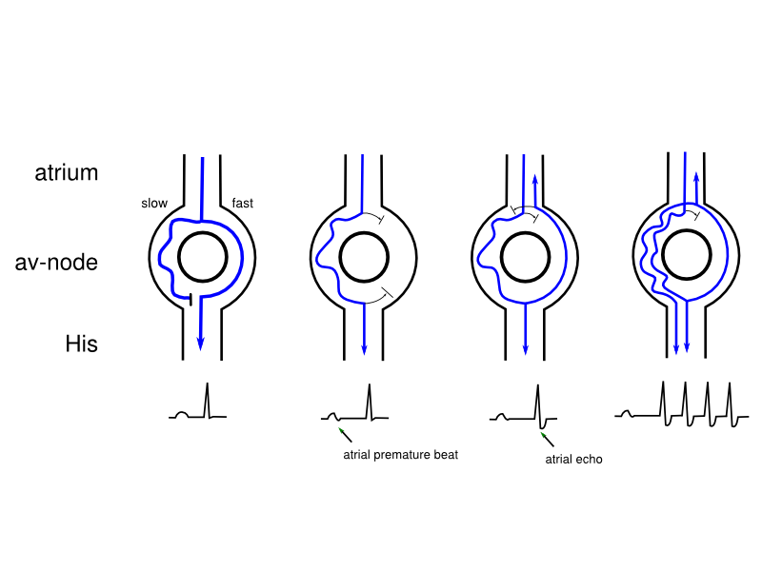
AV NODAL REENTRANT TACHYCARDIA
AVNRT – two pathways through AV node start running in circles
Reentrant loop (like Aflutter), except confined to AV Node
Rate 180-250
P-waves occur flipped and immediately after QRS

Slide 37
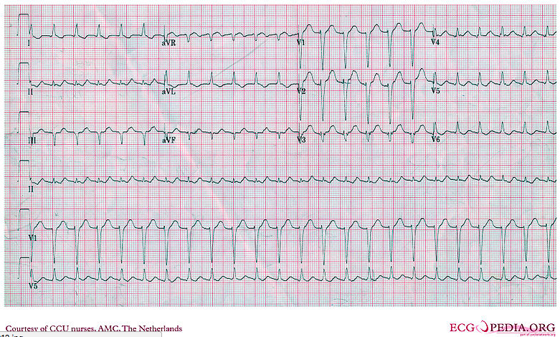
AV NODAL REENTRANT TACHYCARDIA

Slide 38
REGULAR NARROW TACHYCARDIA
What happens if you give adenosine? (AV Slowing)
Vagal maneuvers = same mechanism
check an old EKG for evidence of an accessory pathway first, if available
Rhythm | Result
Atrial Tachycardia | Gradually slow
Aflutter | Slows in increments (or nothing)
AVNRT | Terminates

Slide 39
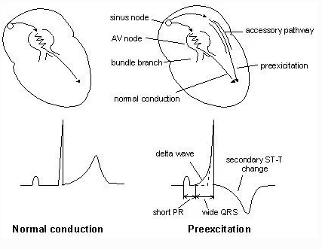
REGULAR NARROW TACHYCARDIA
What happens if you give adenosine? (AV Slowing)
Vagal maneuvers = same mechanism
check an old EKG for evidence of an accessory pathway first, if available

Slide 40
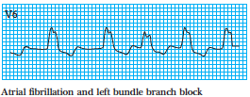
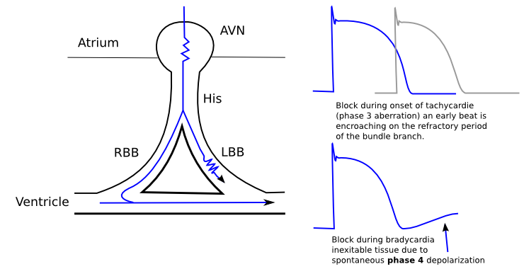
Wide, Irregular tachycardia
Afib (or AFl w/ variable block) w/ Aberrancy:
Consider polymorphic VT if morphology and RR varies
Aberrancy = QRS widening due to delay or block in bundle branch or intramyocardial conduction
If one of the bundles is still repolarizing = like a block
Faster rate = more likely to have aberrancy
Notes:
Ashman’s Phenomenon – presences of aberrantly conducted beats, usually of RBBB morphology, due a long refractory period as determined by the preceding R-R interval.

Slide 41
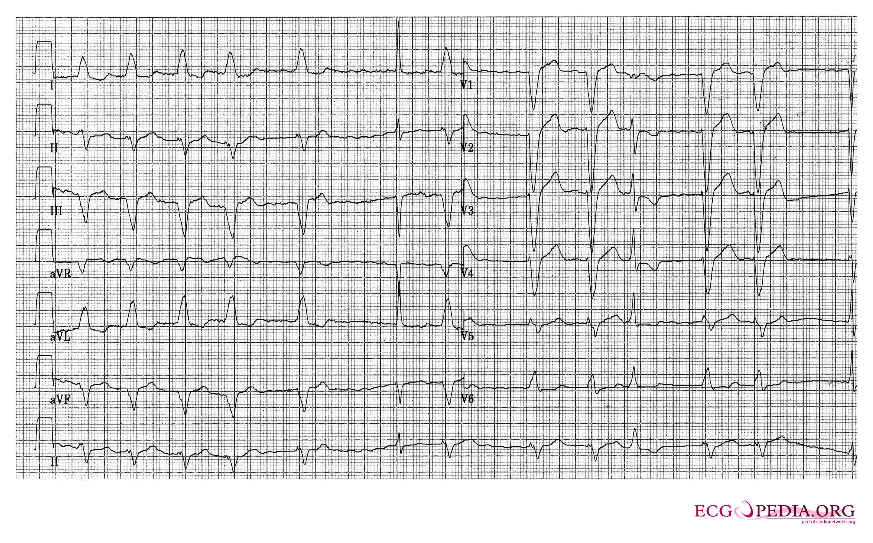
Wide, Irregular tachycardia
Rate dependent left bundle aberrancy

Slide 42
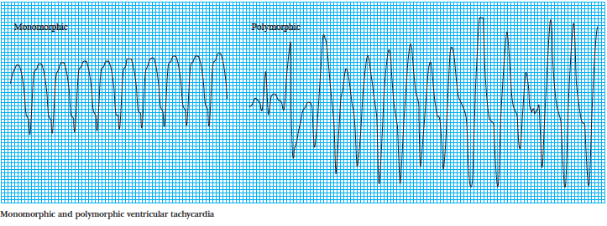
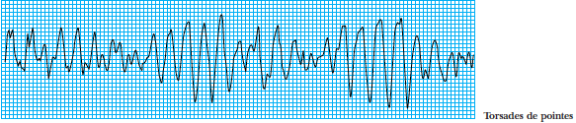
Ventricular tachycardia
Non-sustained (NSVT) = less than 30s
Sustained (NOT abbreviated SVT) = 30s or more
Monomorphic
Polymorphic
Torsades de Pointes = long QTc
VF

Slide 43
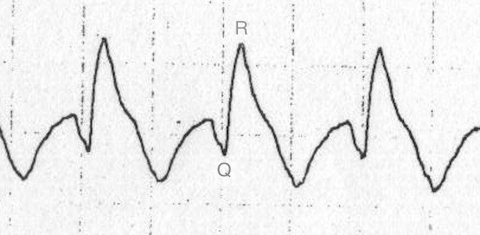
Wide, regular tachycardia
Supraventricular tachycardia with aberrancy vs. VT
NO ALGORITHM TO TELL 100%
QRS 160+ ms => VT
Extreme RWard Axis => VT
Taller L rabbit ear (or non BBB appearance => VT
Age 35+ (PPV 85%), CAD/CHF => VT
Brugada Algorithm
If in doubt, treat as VT

Slide 44
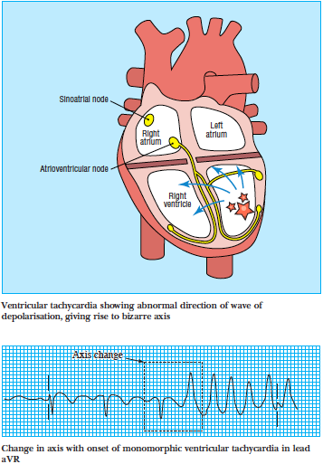
Wide, regular tachycardia
Supraventricular tachycardia with aberrancy vs. VT
NO ALGORITHM TO TELL 100%
QRS 160+ ms => VT
Extreme RWard Axis => VT
Taller L rabbit ear (or non BBB appearance => VT
Age 35+ (PPV 85%), CAD/CHF => VT
Brugada Algorithm
If in doubt, treat as VT

Slide 45
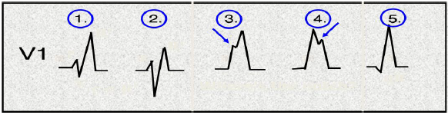
Wide, regular tachycardia
Supraventricular tachycardia with aberrancy vs. VT
NO ALGORITHM TO TELL 100%
QRS 160+ ms => VT
Extreme RWard Axis => VT
Taller L rabbit ear (or non BBB appearance => VT
Age 35+ (PPV 85%), CAD/CHF => VT
Brugada Algorithm
If in doubt, treat as VT
Notes:
1 and 2 = RBBB, 3 likely RBBB. 4 and 5 likely RV origin

Slide 46
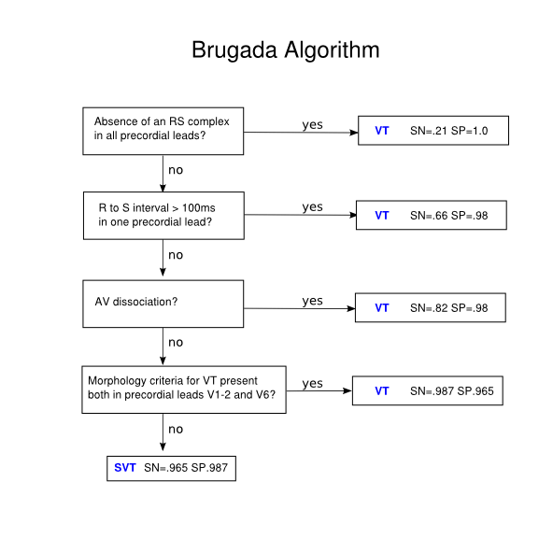
Wide, regular tachycardia
Supraventricular tachycardia with aberrancy vs. VT
NO ALGORITHM TO TELL 100%
QRS 160+ ms => VT
Extreme RWard Axis => VT
Taller L rabbit ear (or non BBB appearance => VT
Age 35+ (PPV 85%), CAD/CHF => VT
Brugada Algorithm
If in doubt, treat as VT

Slide 47
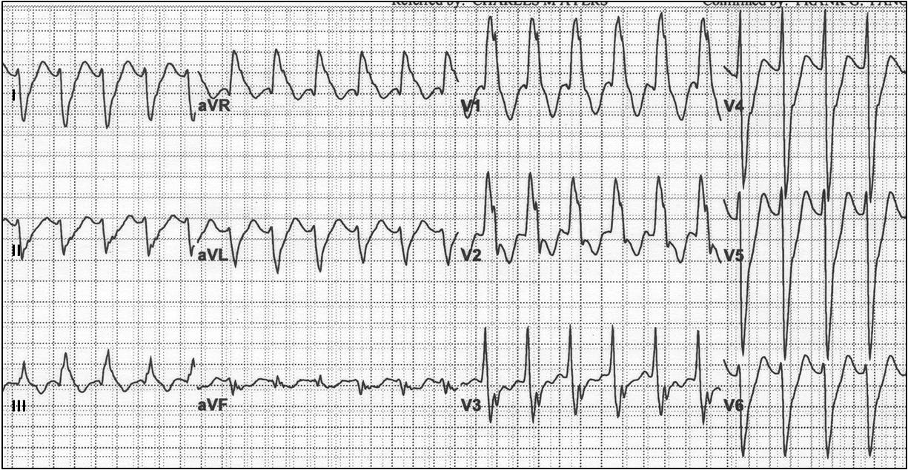
Wide, regular tachycardia
Notes:
VT – LV origin

Slide 48
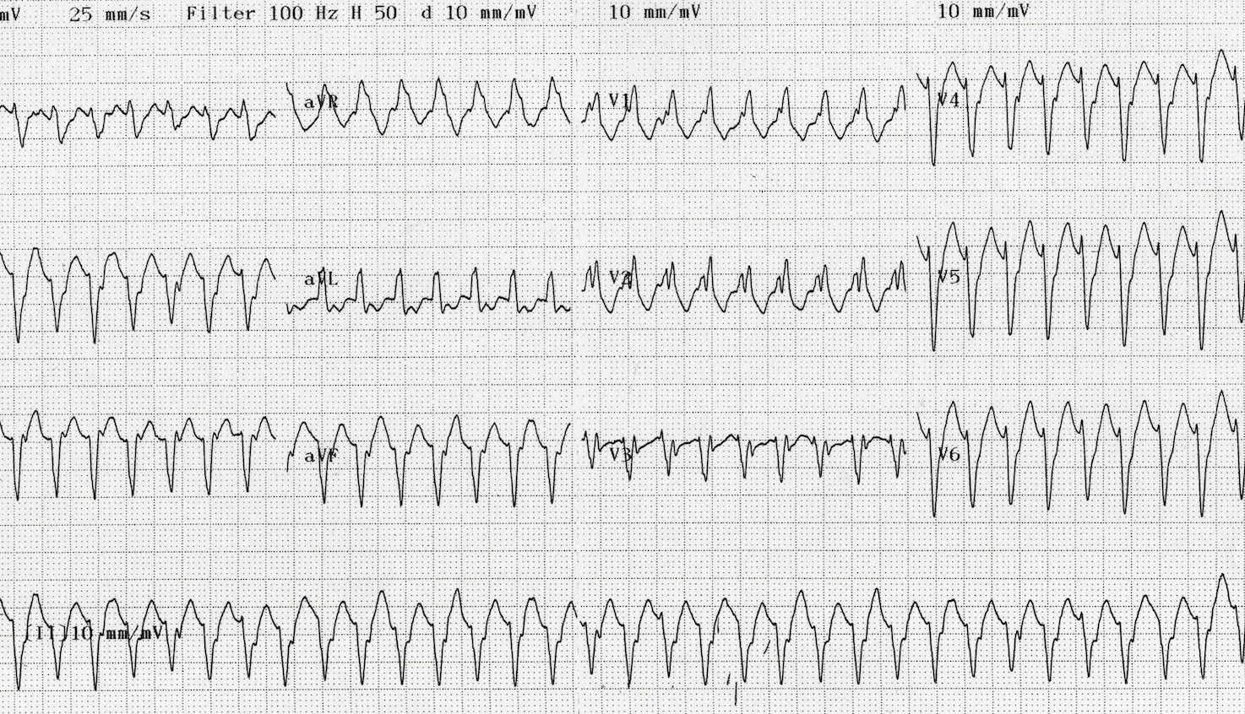
Wide, regular tachycardia
Notes:
SVT w/ Aberrancy

Slide 49
Wide, regular tachycardia
Management:
Unstable (decrease mentation, unstable VS, shock)
VT, SVT with Aberrancy => cardiovert (avoid delivering shock on T-wave -> can cause degeneration to VF)
VF => defibrillate (not timed)
Stable
SVT with aberrancy => manage as above (e.g. adenosine, rate control)
VT -> cardioversion (procainamide or amidoarone if unavailable), pads on, immediate cardiology&ischemic eval.
Notes:
SVT w/ Aberrancy

Slide 50
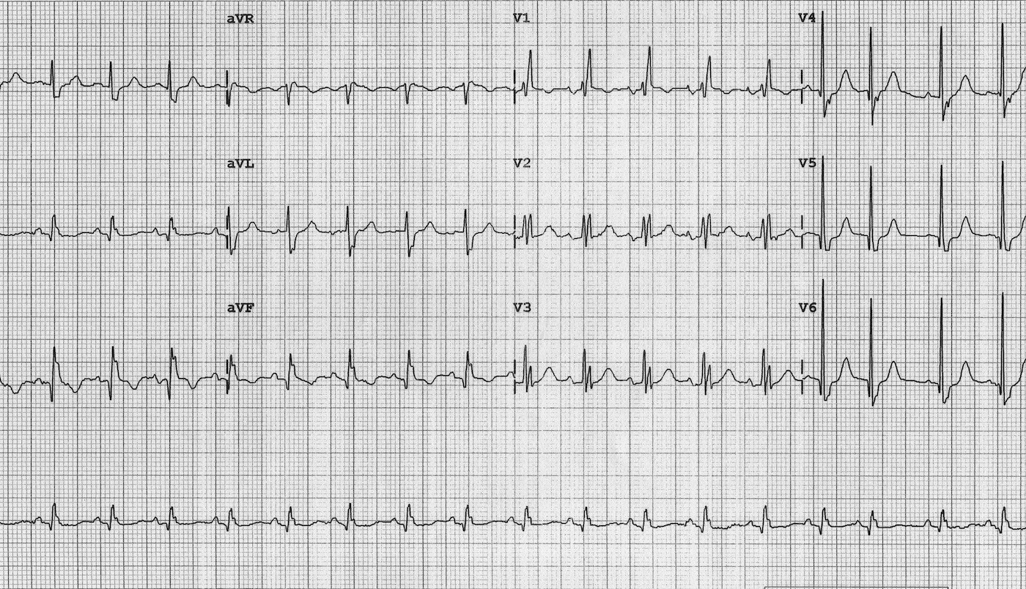
Examples
Notes:
Sinus tachy with RBBB

Slide 51
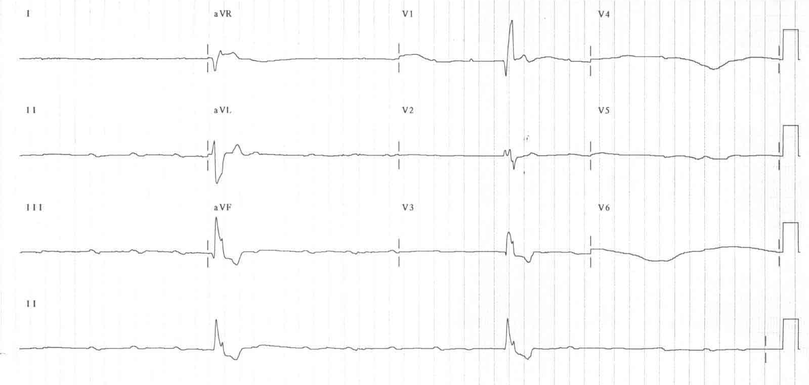
Examples
Notes:
3rd Degree AV block with ventricular escape rhythm (rate ~25)

Slide 52
Ectopic Pacemakers

Slide 53
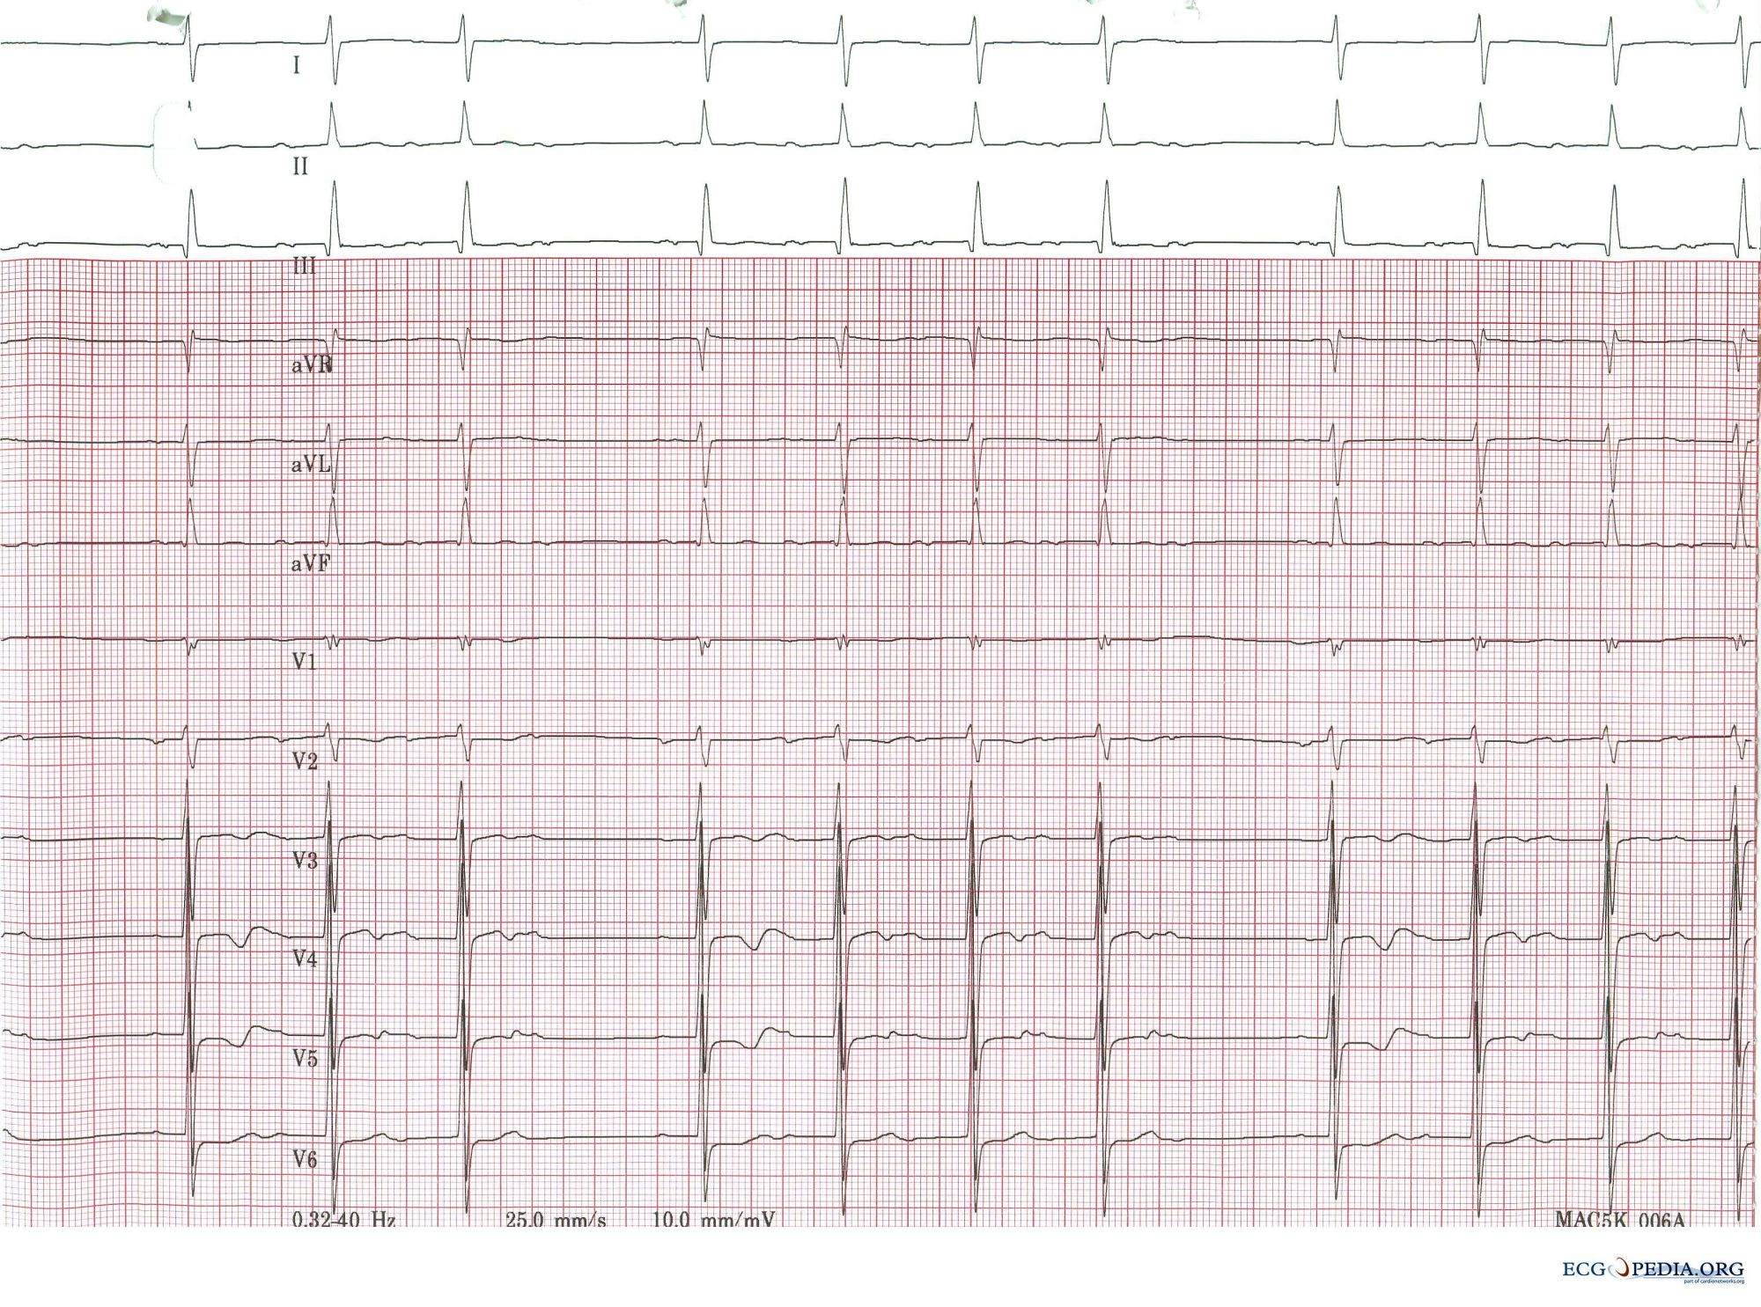
Examples
Notes:
Wenkebock – type I 2nd degree AV block

Slide 54
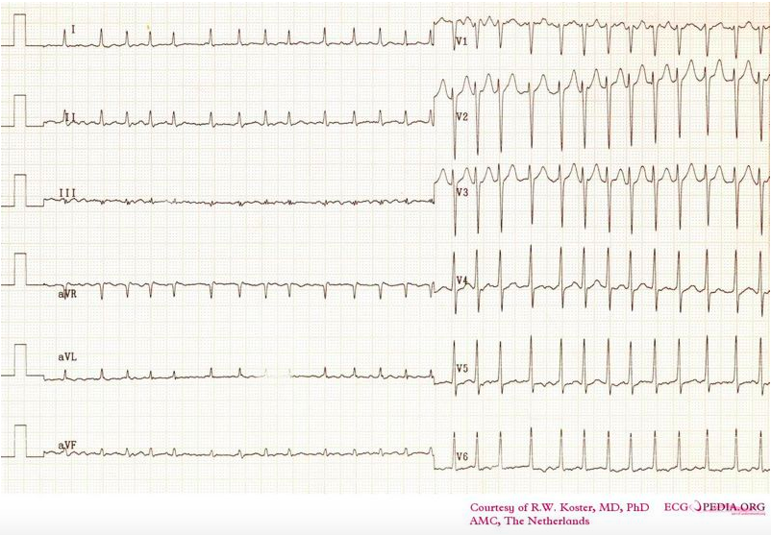
Examples
Notes:
Afib w/ RVR

Slide 55
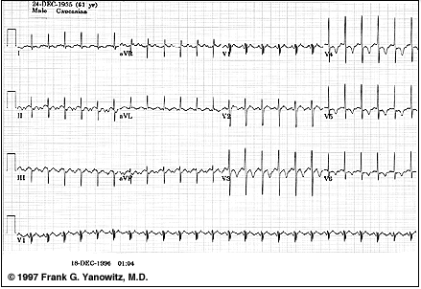
Examples
Notes:
Aflutter 2:1 block

Slide 56
Objectives
Classify arrhythmias by speed, regularity, QRS width to establish a differential diagnosis
Determine if an AV block needs admission/referral for pacemaker placement?
What will occur if adenosine is given to a each narrow complex tachycardia?
Does this wide complex tachycardia require cardioversion, defibrillation, or neither?

Slide 57
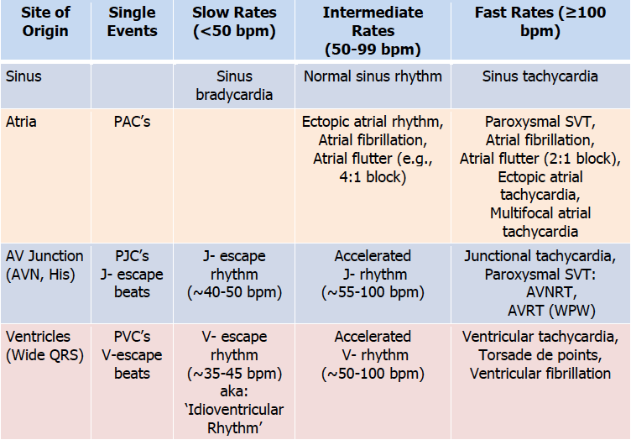
Objectives

Slide 58
Next steps
Accessory pathways, AVRT, SVT w/ pre-excitation
AV Dissociation
PVCs / PACs, Pauses
Paced rhythms

Slide 59
Resources
Tutorials
http://en.ecgpedia.org
https://lifeinthefastlane.com/ecg-library/basics/
Also with links to many resources
Practice EKGs
https://ecg.bidmc.harvard.edu/
https://ecg.utah.edu/
Questions? Brian.locke@hsc.utah.edu

